Slide 1
WAGE Initial meeting (Kick off) General presentation
Arras 11th March 2016
Université d’Artois
Maison de la Recherche

Slide 2
Introduction: summary of the past year and of the current WAGE situation
April 2015. Conference in Arras: Wages and Global Development since 1950/60 (diversity and convergence between advanced/emerging countries)
August 2015. Workshop in Kyoto (World Economic History Congress) about the same topic/problematic
Both sets are resumed in a book to be published by Peter Lang (Bern) for this spring or fall 2016

Slide 3
Call for project: submissions
July 9, 2015. Project WAGE was submitted at the (French) National Research Agency in MRSEI Program (“Building of European and International Scientific Network”)
End October 2015: ANR qualification 30.000 € + First updating of the documents. December, 17: meeting in Paris of the 36 leaders of qualified projects for this call
February 2016: COMUE Qualification to a grant application (call for project "Bonus for International Research Quality" BQRI) at the Community of the Universities of Nord-Pas-de-Calais : 4,000 €

Slide 4
Current constraints
The budget of ANR-funding is administratively open from 11 October 2015 to 11 April 2017, but the funds were not actually available until February 15, 2016 (!). + The national ANR meeting to explain the methodology of the European programs for the heads of the qualified projects took place on December, 17 in Paris.
That explains the date of our meeting only March 11th.
We can meet together after 11 April 2017 with supporting of the ANR budget, but we have to order the spending before that day.

Slide 5
The budget (4000 €) of COMUE-funding is administratively defined between early September 2015 and end of June 2016 and we got the result to 15 February 2016!
We can meet together after end of June 2016 with supporting of this COMUE-budget, but we have to order the spending before that date
Both funding do not finance PhD or purchase of equipment (only <€ 700): working meetings, symposia, publications, website, communication

Slide 6
Our administrative (and financial) support: MESHS Lille
Maison Européenne des Sciences de l’Homme et de la Société (ANR/CNRS)

Slide 7
To discuss today:
Main tasks:
1. Selection of thematic to be analysed
2. Scientific Targets: COST, H2020, Brussels Commission
3. Calendar, budget, organization of work until June 2017
4. Organisation of the network, articulation, networking
5. Deliverables: website, database, archival inventory
Following tasks
6. Communication: mission statement
7. Commitment of each: for what part of the work. Signed.
8. Scientific Project Charter (needs to be re-drafted)

Slide 8
1. Choice of research themes:
The general objective of the WAGE-Network is to better understand the role of wage in the European and in the global economy and the general conditions of improvement of the wage-system
Salaries account for 50% of GDP and 70% of household income in the advanced countries and already 40-45% of GDP and 50% of household incomes in the emerging countries
A significant part of the economic growth comes from wages or is transmitted through them to households

Slide 9
The wage system is too vast to explore and we must make choices. 5 propositions Common topic: impact of globalisation > wage
1. Salaries of youth could be one of our prime targets because it captures many elements.
This is a major European concern and also for emerging countries leaders. Salaries of young = induces the issue of youth employability = also involves training (pay scales > professional profile) and therefore education / University = leads to issue of decent work, which can agree to the ILO

Slide 10
2. The global convergence of average wage
Trend to international price of work equalization through trade and economic globalisation
Heckscher-Ohlin-Samuelson theorems on the processes and the exchange structure and on the remuneration of factors.
International trade will cause the equalization of relative and absolute revenues of homogeneous factors between nations: wage equalization of engineers between them, workers between them etc. equalization in income of homogeneous capital (with same capital productivity and same risk) for all countries that trade.

Slide 11
Global monthly average wage distribution in 2000 and 2012 (2012 PPP$). Source: BIT, Global Wage Report, 2014-15, Graph 19

Slide 12
3.Gender wage gap
Currently, the monthly gender wage gap would be about 45% in Azerbaijan, 42% in Georgia, 40% in Tajikistan, 39% in Russia, 34% in Israel,
But 25% in Canada, around 20 % in Germany, about 18% in the USA and 15% in Poland.
In India, in the formal sector, the gap is currently 25%, but it was 45% in the 1990s; it varies considerably from one Indian state to another, age and qualification. But it is the formal sector: women are still working heavily in the informal sector and in rural areas, where wage differentials of 30 to 50% with men are plausible

Slide 13
In emerging and developing countries, the gap men / women is higher, between 40 and 50%, because women are less qualified, occupy most rural employment and in the informal economy. With the economic and social acceleration, job structure moves to the industry, cities, services and technologies; the gap may increase if the qualification of women has changed little or conversely decrease if the qualification of women follows the general development. The narrowing of the gap can function as a social development index of the country

Slide 14
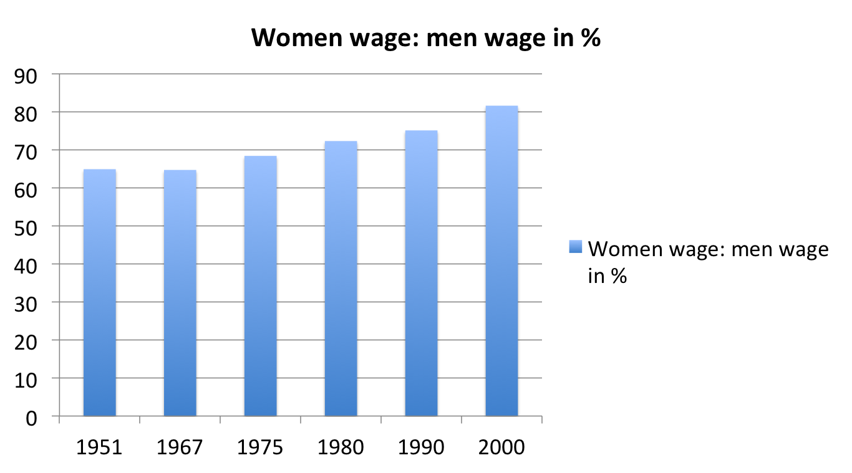
An interesting hypothesis: the historical decline in the gender wage gap in advanced countries (f. e. France) since 1950.

Slide 15
4. Immigration, migrations and wage
A very important topic for the EU.
Our problematic of salaries crosses the salary issue in the Mediterranean and Arab countries (little studied).
The Mediterranean is the contact area of the world, where wages contrasts are the highest (1 to 8 Nominal between Maghreb and France, 1 to 4 PPP for example).
Can be carried out more differentiated calculation of gaps between countries, gender, sectors etc. We have, for example, studies in Morocco on the motivations of emigrants, their hoped financial strategy, they’re minimizing of social risks induced by migration (migrant decommissioning effect in the country of arrival)

Slide 16
5. Decent living wage (empirical analyse)
Akerlof and efficiency wage theory could be a starting point
Employees are usually paid at the market wage. But some companies pay their employees a little above, in order to deploy the potential that exists in the person, because this potential remains still poorly developed with a simple market wage. This develops an improved work, a higher will and commitment to the company. Win-win strategy
Can the gap between market wage and efficiency wage defined as “decent wage”. Which companies practice these wages? Does it work? Terms of transferability of these good practices etc.

Slide 17
2. Choice of call for project
1. Initial choice of a H2020 Eur. Program in 2015 application
For H2020 programs in 2016, the deadline for application (February 2, 2016) was too short.
The 2017 calls concern us very few (even by watching the "gender" programs). Only two identified projects : 1. European commercial policy, 2. statistical investigation of concept "beyond GDP" well-being etc.)

Slide 18
Because to compete, our proposition must cover the entire call (the EU that accredits a single team for programs from 1 to 5 million); this would divert us too far from our target. Or work WAGE is too at the margin
We could consider for example a project H2020 for February 2018 (the list will be known from the summer of 2016 for 2018-19) or February 2019

Slide 19
2. As intermediate solution: a COST call for project
The 2017-18 funding could be provided by a COST project (if we are qualified by EU): European Cooperation in Science and Technology (even possible with this first wave of ANR-Network Program)
Deadline every six months: September 2016 or February 2017.

Slide 20
[Advantages of] COST application
No thematic scope: open field/topic (humanities)
Grant: a lump sum up to € 130,000 for a network under a light steering. Duration: 3 years
Interdisciplinary research program are welcome.
At least 5 peers interested from at least 5 COST countries. Countries outside UE: possible
Light application document: 15 pages maximum
Funding only for networking also (no equipment, no recruitment of PhD or post-doc candidate)

Slide 21
3. Next aim: a H2020 call for project some remarks
At the European level (EU, Brussels Commission) we have to present, not a good or very good project, but an excellent project. One can not expect to get between 1 and 5 million € for a project simply “good” in the hyper-competitive framework of 28 EU states. Striving for excellence is anyway good for our project WAGE, whatever the result
A candidature for a European H2020 project required to covering the entire call field because the EU will not to qualify several complementary projects on the same call.

Slide 22
Some ideas to improve our potential success in application
Put information about our existence on the European NCP network (EU National Contact Points H2020).
Propose to the EU Commission, DG of scientific research, the idea of a call around remuneration / wages as a problem that may generate call H2020 in social sciences for 2018 or 2019 in the challenge "integrative societies ”.
Apply to become expert to the EU, allowing better understanding of the European schemes

Slide 23
In every case an effort of survey or lobbying in Brussels seems to be necessary. For example, in our University colleagues in electric engineering have got from the Region Nord-Pas-de-Calais a 24 months funding for a master degree student in economics for information, networking, soft lobbying in Brussels about scientific policy of the EU (Job: “International Volunteer in Business”)

Slide 24
3. Work organisation
Timetable and budget
Network organisation: governance, repartition of work, eventual stakeholders. Special mention about business partners
Deliverables/output: website, bibliography, future database, recommendations (policy papers) etc.
Mission statement
Scientific document

Slide 25
1.Timetable
2016
March | Meeting of the core team (0) WAGE in Arras (with ILO): organization and strategy
May | Workshop (1) in Geneva: Statistical and Methodological Issues
June | Start of operation of the website
September | Workshop (2) in Bochum, Copenhagen or Padua: Economic Agents and wage sectors, companies and countries
September | First application to an European call for project COST
Fall | Publication by Peter Lang (signed contract) of Wage and Globalization since 1950: Disparities and convergence, from the eponymous symposium of Arras (April 2015) followed by a workshop in Kyoto (Japan, WEHC, August 2015)
November | General meeting (3) of the WAGE network in Arras / Lille: social, government and industrial relations partners: decent work, public and private wage strategies

Slide 26
2017
February | Second application to an European call for project COST
March | Workshop (4) in Marrakech: EU salaries in globalization (comparative analyses with emerging countries).
April | Publication of the main original analysis from the project WAGE (printed book n°2)
May | Drafting and rendering the final report of the BQRI part of the project WAGE
June | Drafting and rendering the final report of the ANR-MRSEI part of the project WAGE
2018
February | Application to a European call for project H2020 (SHS)
August | Proposal of a workshop (5) to the World Economic History Congress (WEHC) in Boston (USA)

Slide 27
2. Budget (provisional)
 | ANR-MRSEI April 2017 | COMUE-BQRI June 2016 | ANR + COMUE
Initial Meeting (0) in Arras of the “core team” for general organization with ILO | 4000 |  | 4000
Workshop 1 Geneva at the ILO (statistics/methodology) | 2000 | 3000 | 5000
Workshop 2 in Bochum or Copenhagen or Padua (sectors, firms) | 4500 |  | 4500
General Meeting 3 WAGE Arras-Lille Nov. 2016 | 6000 |  | 6000
Workshop 4 Marrakech, Emerging countries | 4000 |  | 4000
Missions of the coordinator or core team to expand the WAGE network | 850 |  | 850
Preparation of website, archival inventory, data-base | 2000 |  | 2000
Communication actions and project of survey of regional businesses (testing the social consulting project) | 2500 | 1100 | 3600
Communication actions, publication and promotion of the project | 3000 |  | 3000
Administrative taxes | 1150 |  | 1150
Total | 30000 | 4100 | 34100

Slide 28
3. Network organisation Governance
Organisation of the network: f. e.
1. core team 2. main contributors/collaborators 3. specific or external partners (experts, consulting)
Internal communication (MEHSH platform)
Internal and external bodies
Consortium agreement (to sign among us) with a charter form for the solution of human or strategic problems, and solution procedures in case of abandonment of a partner, failure of working of another partner etc.
Extension of the network/Cooperation possibilities

Slide 29
Partners, stakeholders, interlocutors
Check that the project meets a real need for society or economy (not what we imagine).
Identify end users (and the expected solutions), consult them, meet them and include them in the partnership: e.g. the patients as part of a medical project, the farmers in an agricultural project, and the researchers, policy makers etc.
In our case, we have to meet the employers, unions, “basic” employees themselves (social samples), Administrations of Labour, of Statistics etc.

Slide 30
Looking for partner companies.
Target the "social responsibility of business." Companies are interested in a "social management control" of their operations and their strategy. So does their image in their "social audit". Currently, it is a growing market, especially occupied by the consulting groups
Our expertise would be much appreciated: we must examine the issue with bosses (to view and probe their needs). Go to the bosses with an idea of shared gains as "win-win", not as seekers of funds or advice: "we bring you something".
To identify the partners, there is a network of the European Commission, 600 partners, with an interlocutor in every region: Enterprise Europe Network. This research group with a completely European card can find all types of partners in EU

Slide 31
4. Deliverables/output website, bibliography, future database, recommendations (policy papers) etc.
Be able to explain the WAGE project in a few words. Project, problem, methodology and proposed solutions concentrated in one sentence. In terms of marketing: what is our mission statement: what is it, why and for whom? Etc.
(E.g.: What decent living wage for young Europeans?)

Slide 32
Impact assessment
it accounts for 1/3 of the note in European projects. Researchers are poorly prepared for this exercise.
In foreign policy, for example, in the current issue (since 2014) of Ukraine, the EU expects shaped recommendations of public policy, their recipients, some policy-briefs, a data-base of usable networks like agencies development of parliamentary friendship groups, in short, an estimate of the time needed to diplomatic work and of the number of people to recruit or use for it. In some cases, this will involve recommendations to companies, for example, trade unions, public authorities.

Slide 33
Another project related to collective memory issues proposed a video game: it also had to assess the cost, the nomination process of the SMEs, which would be eligible for its manufacture etc.
Then we have to be realistic: do not write policy papers with 50 pages and take contact (if necessary) with a communication agency for it. The "impact evaluation" can strongly differentiate between several projects in competition. The national cell-support (UE-NCP-SHS) can help in this part; it has access to surveys etc.

Slide 34
Risk analysis
Take into account the risk analysis (which is not a prediction but a hypothetical programming). The project is starting on an assumption of functioning: alternative solution.
List the types of risks: cost (failure of an actor or SMEs), human risk (departure of a partner), time-risk (not enough time).
Use e.g. the SWOT analysis (strategic analysis matrix summarizing synthetically strengths (Strengths), weaknesses (Weaknesses) and threats (Threats) and opportunities (Opportunities) of a proposition): strengths, weaknesses, better communication between partners etc.
From the analysis of the risk itself solutions can be found. Provide an output protocol of problem f. e. in case of defaulting partner

Slide 35
Define and think / plan the post-project.
From the start, to whom will serve the project? What other actors? How will the project work? Steps between the end of the project and its marketing or use? We have to involve the different types of users and imagine an plan operations, described in the impact section of the proposition

Slide 36
> 5. Mission statement
Be able to explain the WAGE project in a few words. Project, problem, methodology and proposed solutions concentrated in one sentence. In terms of marketing: what is our mission statement: what is it, why and for whom? Etc.
Better wage for better growth
Decent wage for better productivity etc.

Slide 37
6. Scientific document
Scientific Project Charter: the document of July 2015 (application to ANR call for project) needs to be re-drafted

