Slide 1


Wages problematics since the 1930-
1950s
Elements of comparison between Europe and Latin-America
Michel-Pierre Chelini
Professor for Economic History
University of Artois/Arras (N-France)
Montevideo Conference 31.10.2017

Slide 2
Plan of presentation
1. Wage evolution from 1950s through today
2. Wage dispersion
3. Wage policy

Slide 3
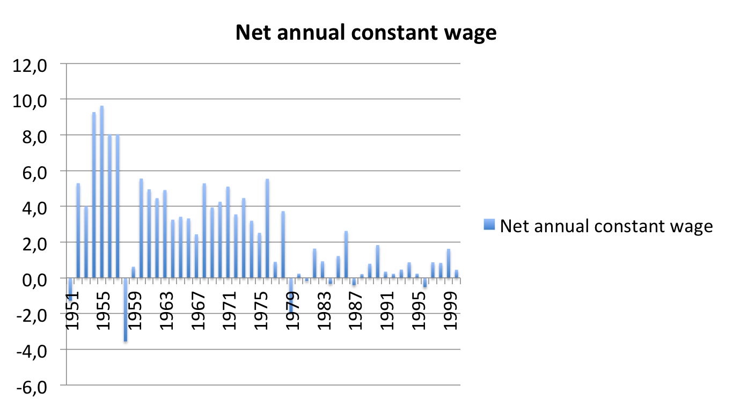
1. An evolution in two periods: rapid wage growth until 1980, slower from 1980 through today
France yearly annual net wage 1951-2010

Slide 4
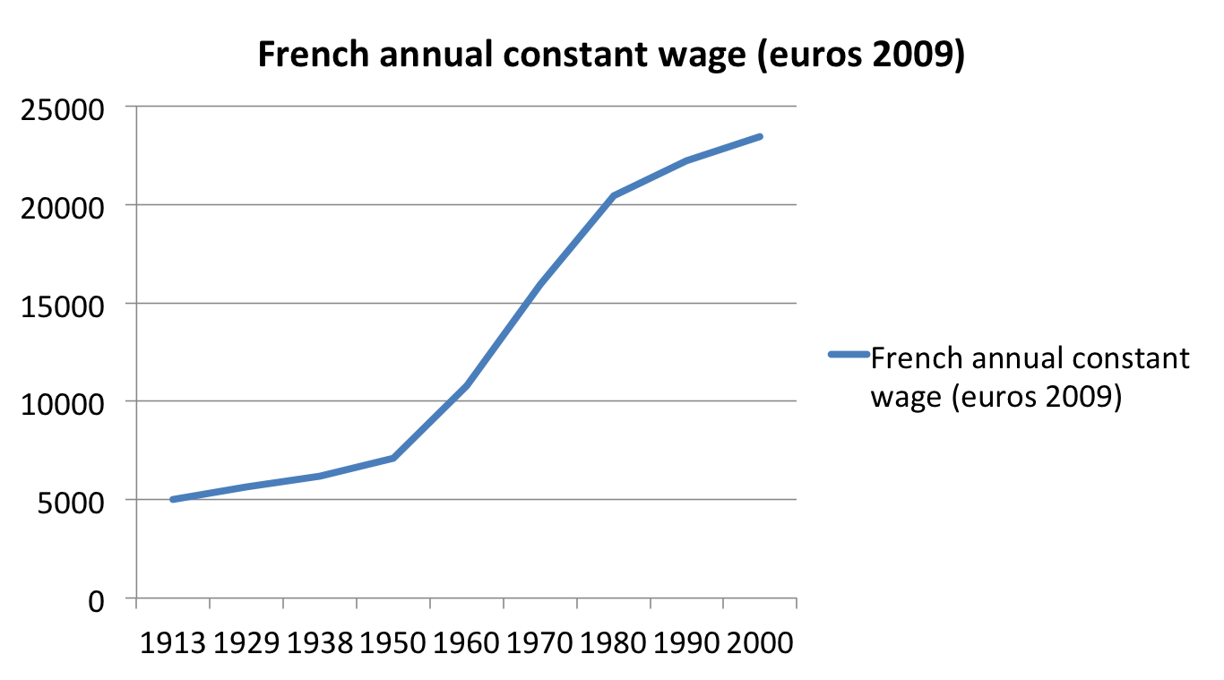
One century of French annual constant wage (average) in constant euros 2009

Slide 5
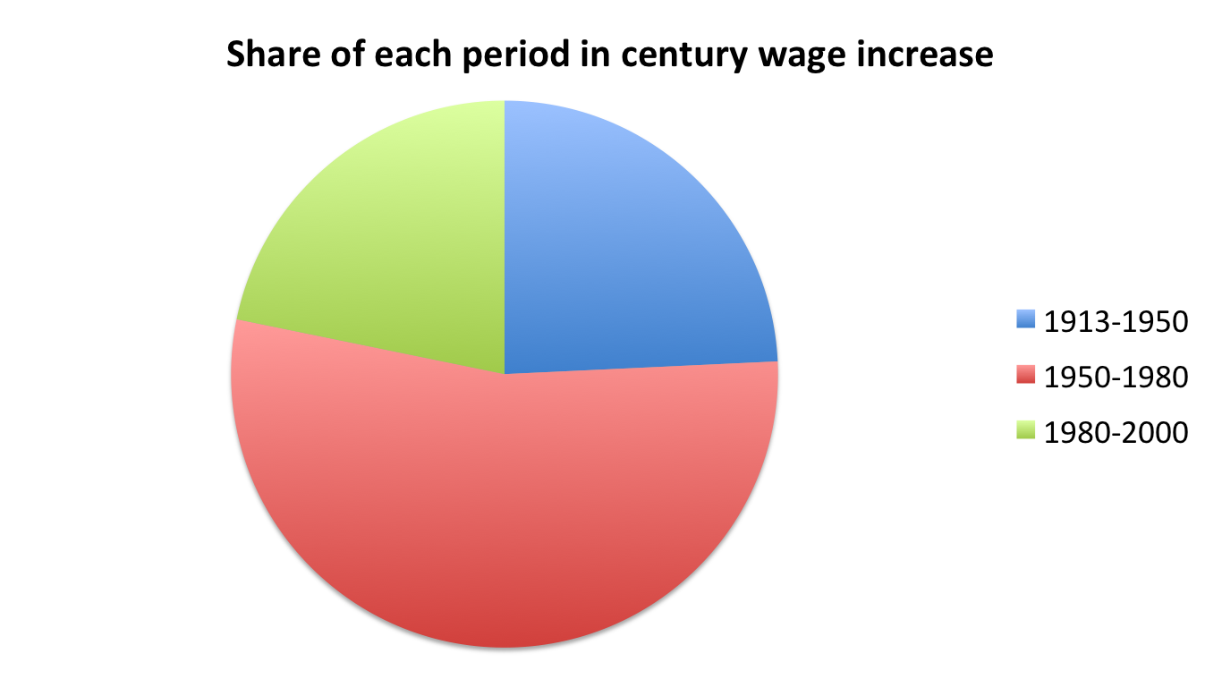
Three distinctive periods in French wage increase 1913- 2000

Slide 6
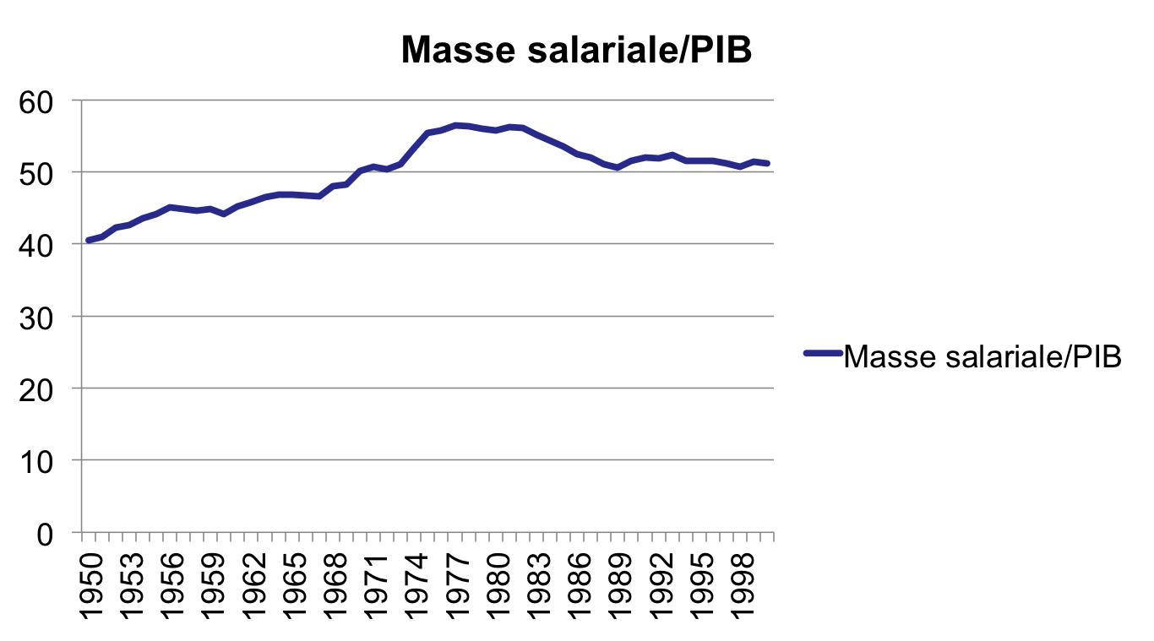
Wage share in France 1950-2000
(Total payroll/GDP %)

Slide 7
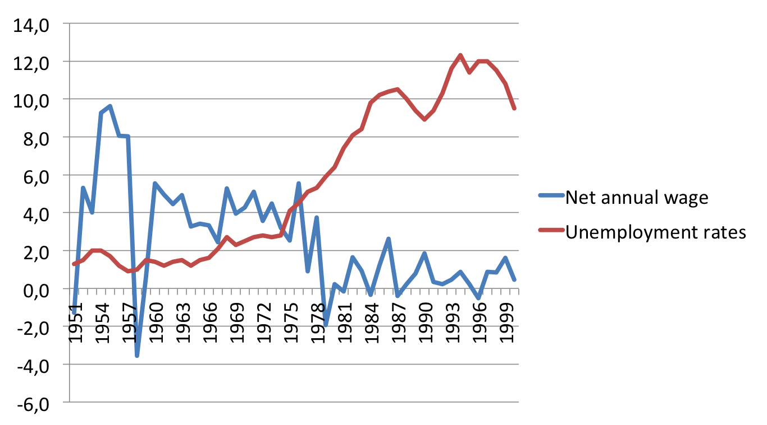
This development is the opposite of that of unemployment: low unemployment, sharp rise in wages (and vice versa)

Slide 8
On the other hand, it is parallel to GDP, which is logical: the company can not redistribute less than value added + profits, investments, etc.
France, net annual constant wage/GDP

Slide 9
Net annual constant wage and productivity, France 1951-2000

Slide 10
Hourly labour cost and productivity, France 1951-2000

Slide 11
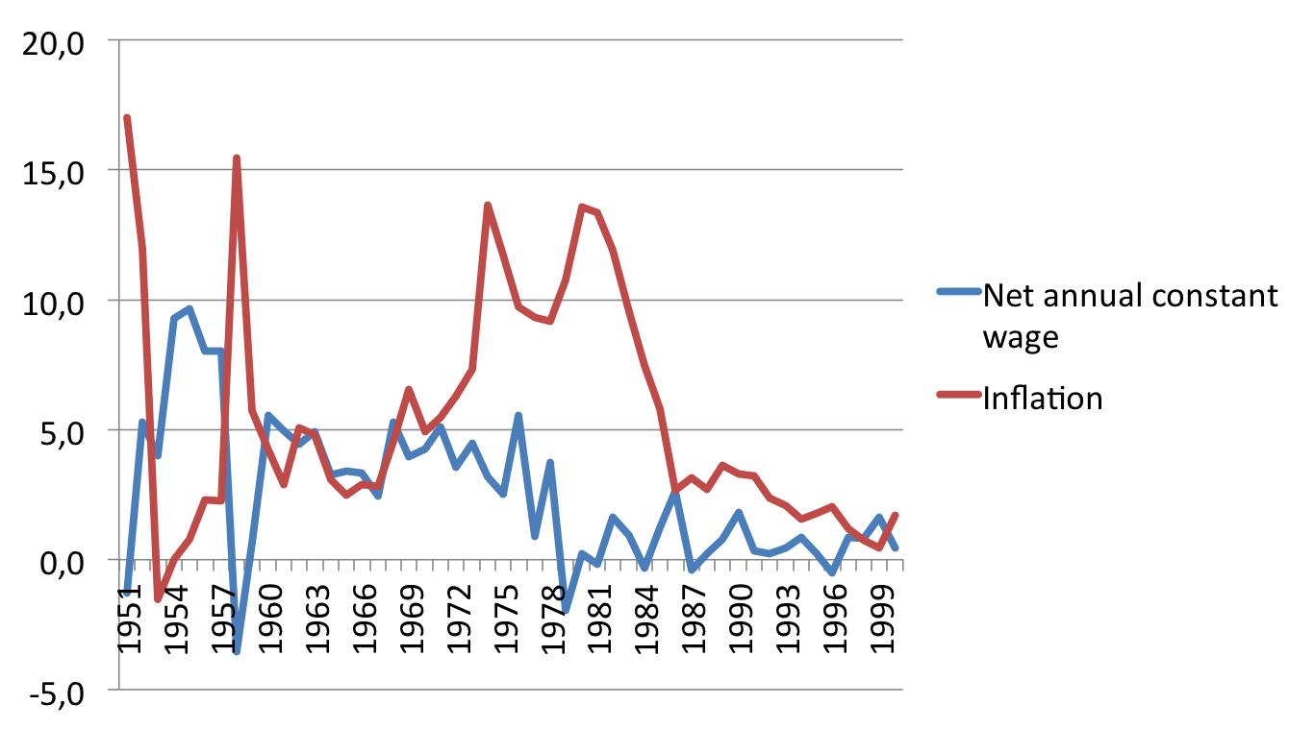
The price-wage link exists, but with a sharp decline in 1973-86
France, net annual constant wage/inflation

Slide 12
Since 2000, wages are increasing rapidly in Asia, but slowly in developed countries (and in Middle East)

Slide 13
Since 1995, global wages evolve around 2% per year and GDP of around 4%
World GDP : 3.5 to 3.8% per year
Average wages : 2%
Advanced countries : 1%
Emerging countries : 3 to 5% (heterogeneity)
China : between 5 and 8%
India and Brazil : around 3%
ILO Global Wage Reports, passim (2008-2015)

Slide 14
2. Wage dispersion
Dispersion: arithmetic distribution of values relative to the average
Difference : gap between two or more things (/people, values) to distinguish them (/nature, quantity, quality, potentiality)
Disparities: deemed disproportionate distribution by a given society
Inequalities: (sociology) Difference in access to scarce and valued social resources (education, power, culture, capital, income)

Slide 15
Typology of wage gaps in the French case since 1951
Type of gap | 1950-51 | 1967 | 1983 | 2000 | 1950-2000
Inter- decile D9/D1 | 3,4 | 4,1 | 3,1 | 3,1 | - 9%
Executive / unskilled w. | 3,32 | 4,53 | 3,05 | 2,61 | -22%
seniors (61-65) / juniors (21- 25) | 1,52 | 1,50 | 1,78 | 2,63 | +73%
Men/women | 1,54 | 1,54 | 1,35 | 1,22 | -21%
Paris region / Limousin | NA | 1,66 | 1,38 | 1,46 | -12%
Energy /industry sector | NA | 1,28 | 1,36 | 1,39 | +8,5%
>1000 employees / <10 employees companies | NA | NA | 1,42 | 1,38 | -3%

Slide 16
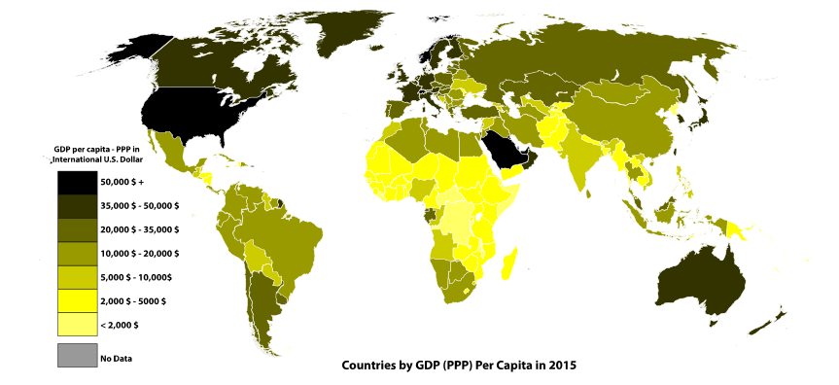
Europe in general maintains a high standard of living: GDP per capita PPP 2015

Slide 17
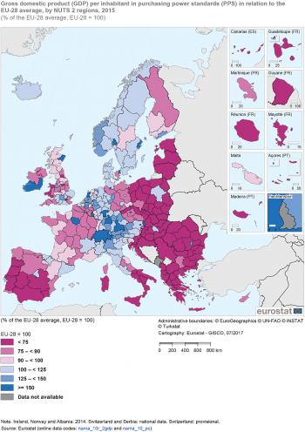
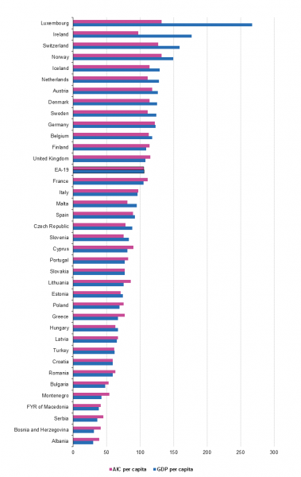
But with significant differences between states and even between regions (2016, GDP/capita PPP)

Slide 18
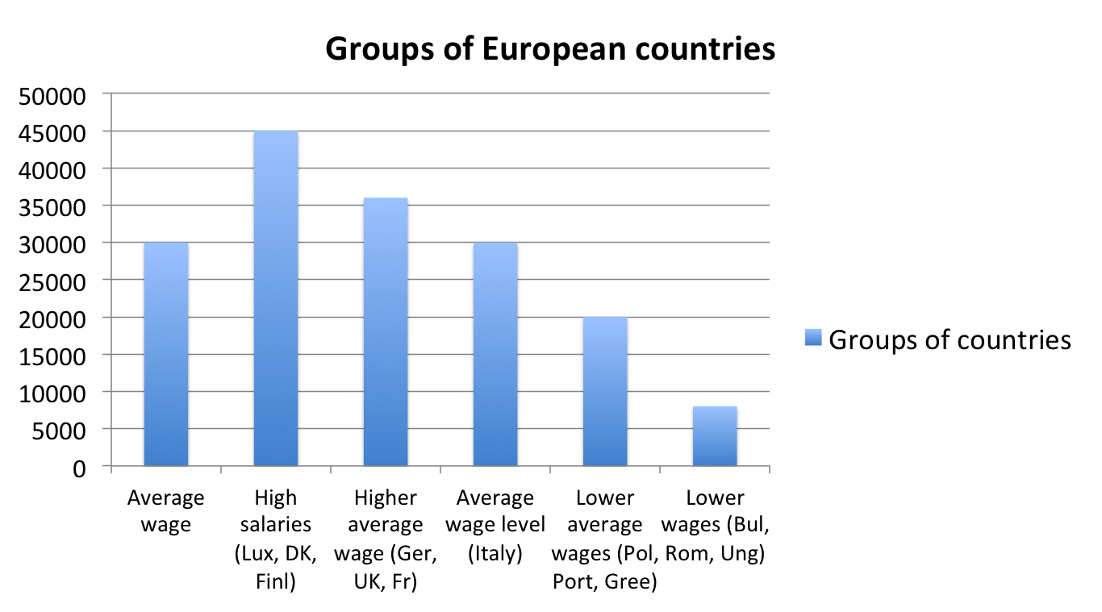
Geographic dispersion of average wage inside European Union 2012: extreme gap 1 to 5, standard deviation/average 1,5 main groups of countries by average wage level (annual gross salary)

Slide 19
A quite low inter-deciles ratio in comparison with other continents (Here D9/D1 since 1995)

Slide 20
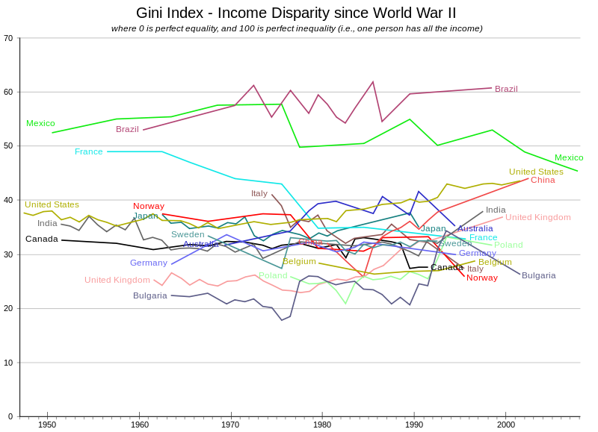
A low Gini coefficient of income (including wages) since 1950, Europe has been around 25-35 since 1950

Slide 21
Filling the gender wage gap: high in 1950, gradually filled between 1965 and 2000, stable (20%) since 2000. France 1950-2010

Slide 22
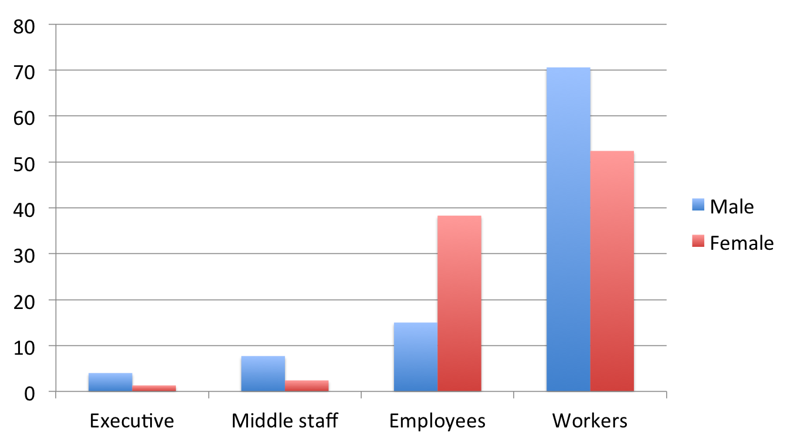
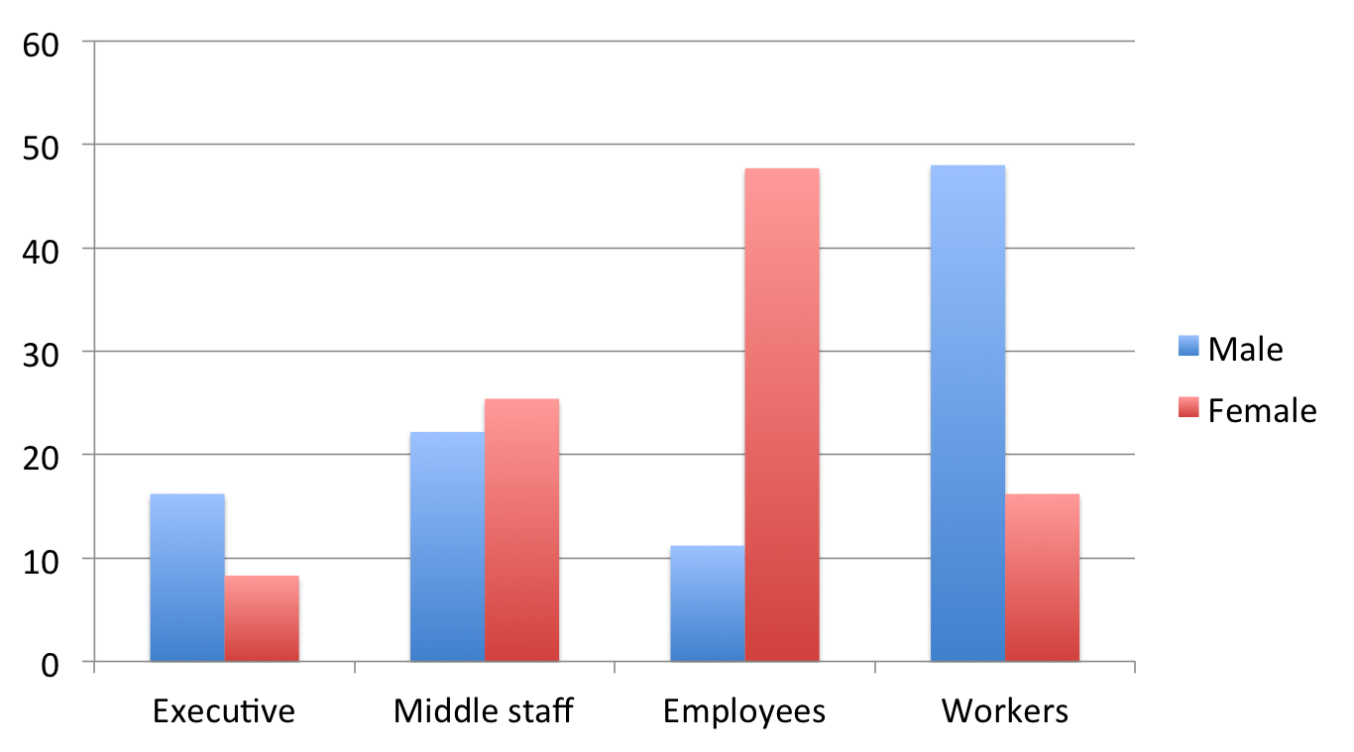
The residual gender wage gap is explained by a difference of qualification
(France gender workforce distribution in 1952, left, in 1995, right)

Slide 23
Junior/senior, three kind of ”solutions” in Europe: age distribution of wages in 2006
Source: OECD 2006 live longer work longer p.66 (male full time employees)

Slide 24
3. Wage strategy, wage policy
State policy for officials, civils servants
State policy for minimum wage
Companies wage policies
Unions wage strategies
Individual wage strategy : qualification or entrepreneurship

Slide 25
Wage policy in W-Europe: since 1950, supervision and regulation.
1. Explicit wage policy
Encouragement of collective bargaining (branch level)
Fixing of the minimum wage,
Fixing the wages of nationalized companies (until the 1980s)
Sometimes, a set of short-term actions such as formal recommendations for moderation or stabilization plans (French "speciality", f. example 1952, 1958, 1963) and 1974-79 for EEC

Slide 26
2. Indirectly actions on the wage bill:
fiscal policy, with remunerations of officials and volume of public orders
customs policy or competition policy
modernization of communication infrastructure (> net job creation)
school policy, especially in 1950-80, acting on the payroll, by the payed personnel or materials and by the qualification of the formed pupils/high school students/U. students
The social insurance system (health, family, pensions, unemployment): contributions-benefits (25% of GDP) more than the state budget (22%)

Slide 27
Importance of minimum wage policy (France)
Chronological steps in France
1936: first definition in some sectors (steel)
1950: legal minimum wage for all sectors (SMIG, interprofessional) indexed on price evolution
1970: legal minimum wage indexed on economic growth (SMIC)
In Europe people think that the minimum wage is good for workers, although it remains low: it allows a formalization and institutionalization of the employment relationship

Slide 28
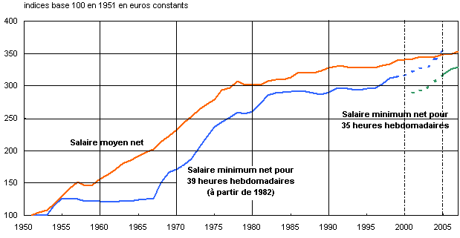
France yearly annual net average wage and minimum wage 1951-2010

Slide 29
Minimum wage in France, how much people is concerned?
Average part of employees/workers payed to minimum wage: 10% (2 million people)
Average part of employees/workers in the vicinity of minimum wage : 20 to 30%
Average level of minimum wage: 40 to 50% of average wage (with evolution 1950-2015, cf. slide 6 “salaire minimum”)

Slide 30
The European Union is not an economic homogeneous space: dispersion of the current minimum wage (2014) out of 21 countries (8 do not have an Interprofessional minimum wage)

Slide 31
For conclusion: in order to compare
1. Gross monthly average wage in US $ PPP 2012
Raw classification in three groups

Slide 32
2. Monthly average wage (gross) in advanced and emerging countries in U.S. $ PPP 2012
A significant dispersion of wages by states

Slide 33
3. Global monthly average wage distribution in 2000 and 2012 (2012 PPP$). Source: BIT, GWR, 2014-15
With a short movement to convergence?

